Slide 1
Detection of AI Generated Images
Riski Adianto
Saira Faiz
Colby Jamieson
Karl Yazigi

Slide 2
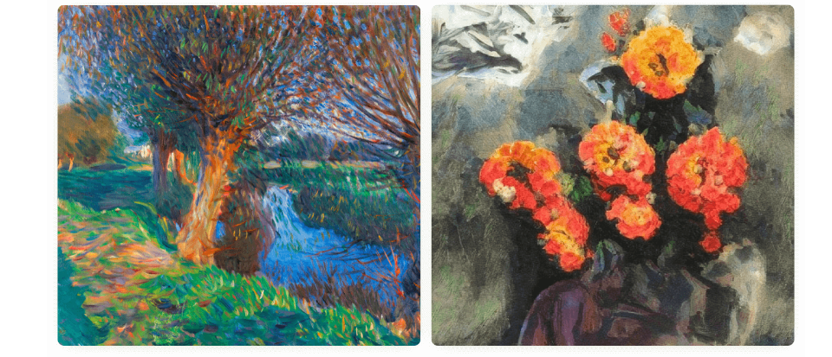
Introduction
What do you think?
Which one is a real painting and which is AI-generated.
A
B
A is a real painting and B is AI-generated
B is a real painting and A is AI-generated

Slide 3
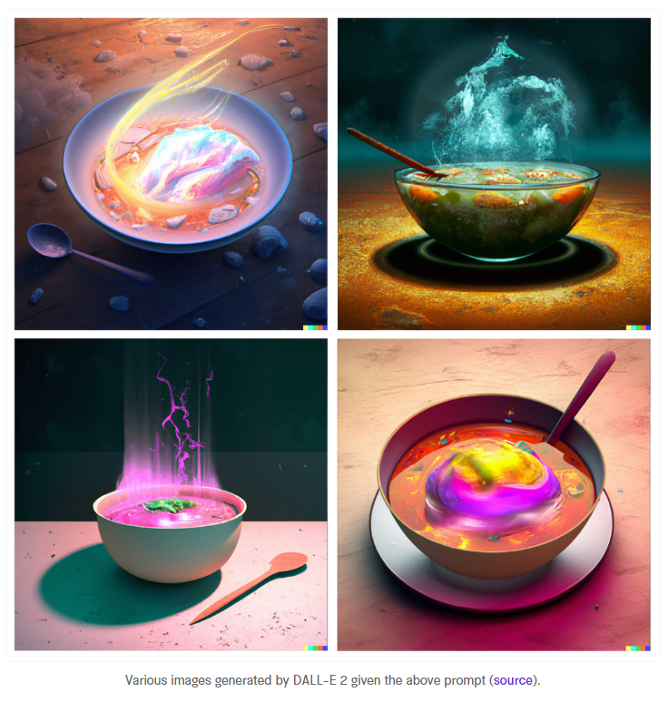
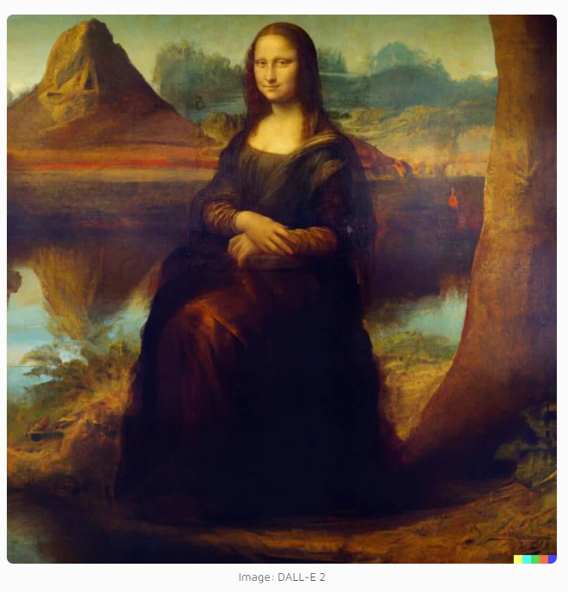
Introduction
"a bowl of soup that is a portal to another dimension as digital art".
What are the capabilities of DALL-E?
DALL-E 2 can create photorealistic images based on prompts and textual description
DALL-E 2 can modify or extend existing images
Edits features such as hairstyle, nose, face, gender
Create background based on textual description

Slide 4
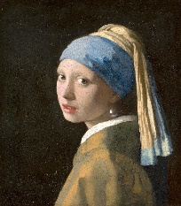
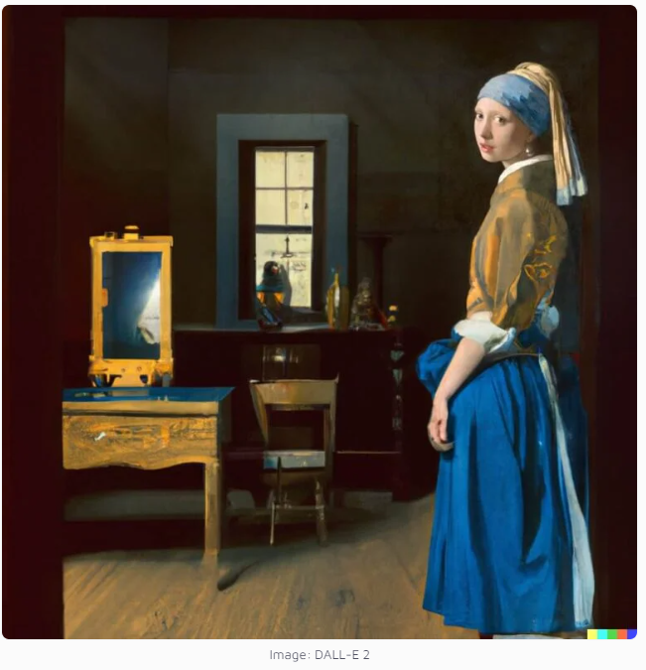
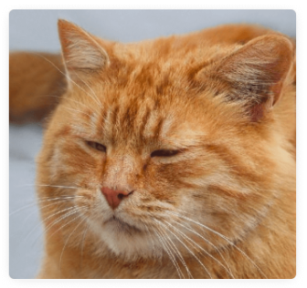
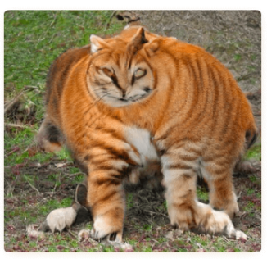
Introduction
Shortcomings of AI generated images
It’s still difficult to draw certain parts of the body, like hands
It can mix different images

Slide 5
Objective & Scope
Whether the model can detect, if the image is AI generated
Automated identity verification, forensics, deepfake technology
Improve the capabilities of AI
By developing algorithms that can distinguish between images generated by machines and those captured by humans
Robotics, autonomous vehicles, and surveillance systems

Slide 6
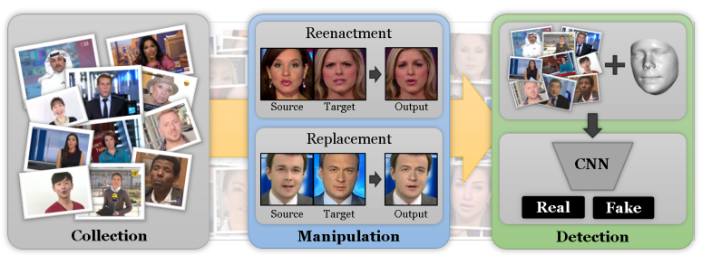
Related Work
Much work has been done on detection of deepfake videos where facial expressions are manipulated, or facial identity is being manipulated
FaceForensics++: Learning to Detect Manipulated Facial Images
by Rössler et al. (2019)
Detecting Image Splicing in the Wild (Web)
by Zampoglou et al. (2015)

Slide 7
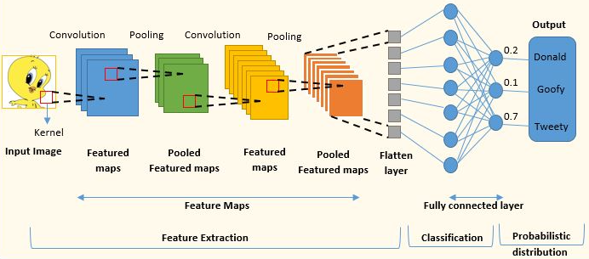
Methodology
Convolutional Neural Network (CNN) was used for the model
Typically used to do image recognition and processing
Designed to process pixel data
CNN utilizes two main operations:
Convolution
Pooling
https://www.analyticsvidhya.com/blog/2022/01/convolutional-neural-network-an-overview/

Slide 8
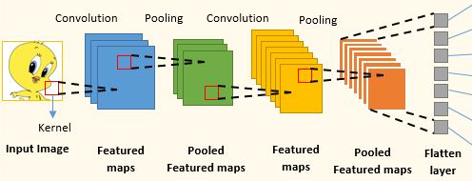
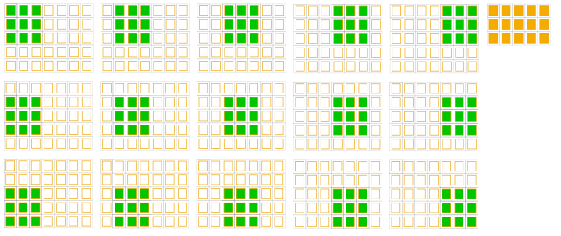
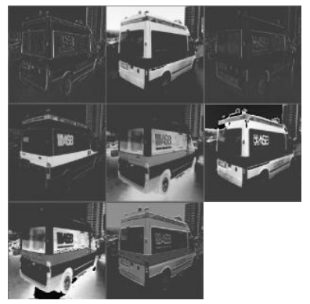
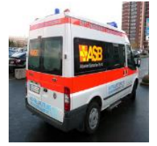
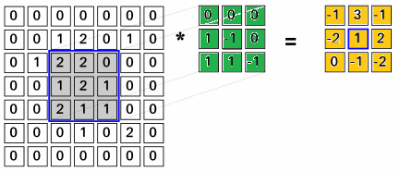
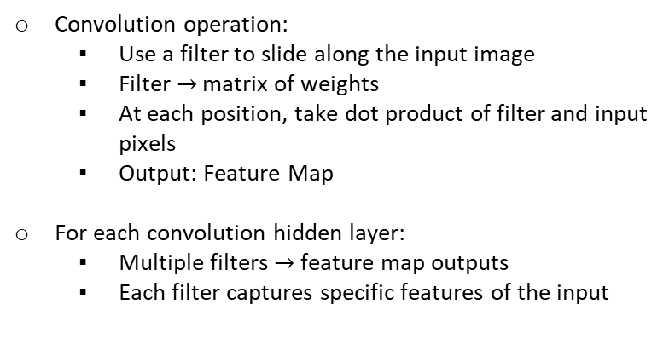
CNN Convolution
Convolution operation:
Use a filter to slide along the input image
Filter $→$ matrix of weights
At each position, take dot product of filter and input pixels
Output: Feature Map
For each convolution hidden layer:
Multiple filters $→$ feature map outputs
Each filter captures specific features of the input
Filter
Input Image Pixels
Feature Map
https://www.uio.no/studier/emner/matnat/ifi/IN5400/v21/lecture-slides/in5400_2021_w5_lecture_convolutions.pdf
https://deepai.org/publication/exploring-linear-relationship-in-feature-map-subspace-for-convnets-compression
https://www.cosmos.esa.int/web/machine-learning-group/convolutional-neural-networks-introduction

Slide 9
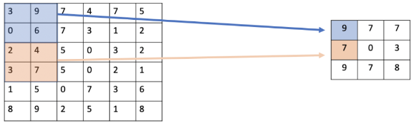

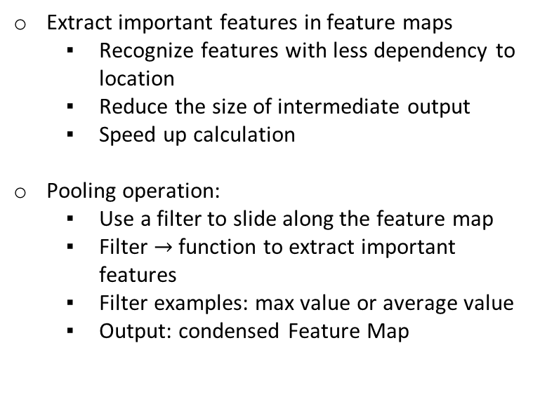
CNN Pooling
Extract important features in feature maps
Recognize features with less dependency to location
Reduce the size of intermediate output
Speed up calculation
Pooling operation:
Use a filter to slide along the feature map
Filter $→$ function to extract important features
Filter examples: max value or average value
Output: condensed Feature Map
Max Pooling
Average Pooling
https://programmathically.com/what-is-pooling-in-a-convolutional-neural-network-cnn-pooling-layers-explained/

Slide 10
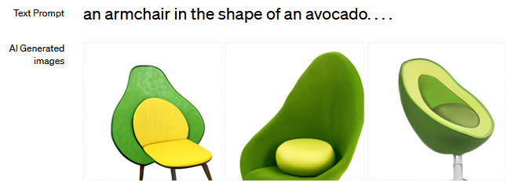
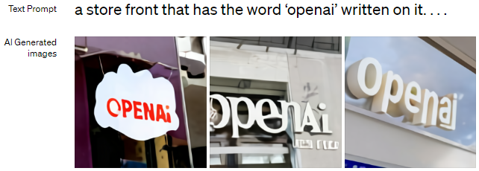
DALL-E
AI image generator developed by OpenAI
Generate images from an input text
Use a dataset of text-image pairs
Able to combine unrelated concepts in realistic ways
Multimodal implementation of OpenAI Generative Pre-trained Transformer (GPT) model
Development:
DALL-E released in 2021
DALL-E 2 released in 2022, with higher resolution & better photorealism
https://openai.com/research/dall-e

Slide 11
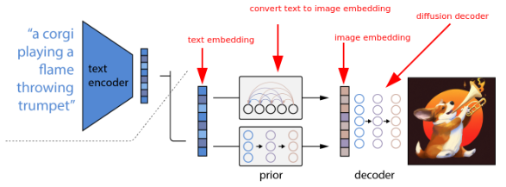
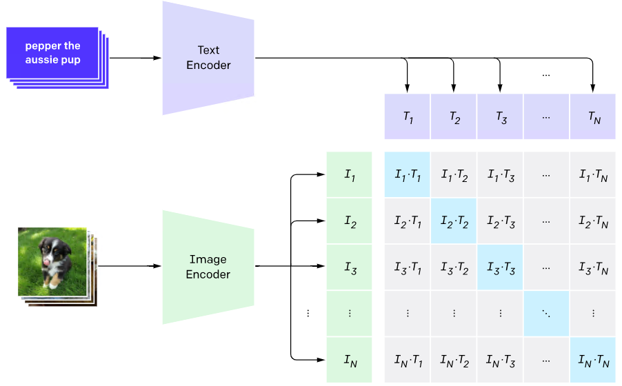
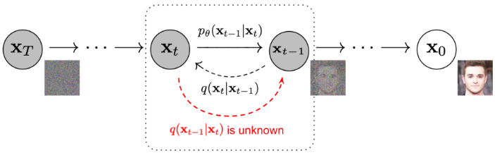
DALL-E 2
Component 1: CLIP
Contrastive Language-Image Pre-training
Text and image transformers
Connect image and text description into an image embedding
https://vaclavkosar.com/ml/openai-dall-e-2-and-dall-e-1
Component 2: Diffusion Model
Based on GLIDE (Guided Language-to-Image Diffusion for Generation & Editing)
Generate high-quality image from image embedding
Vaswani et al (2017) – Attention Is All You Need
https://lilianweng.github.io/posts/2021-07-11-diffusion-models/

Slide 12
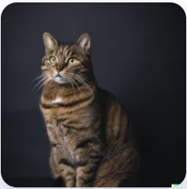
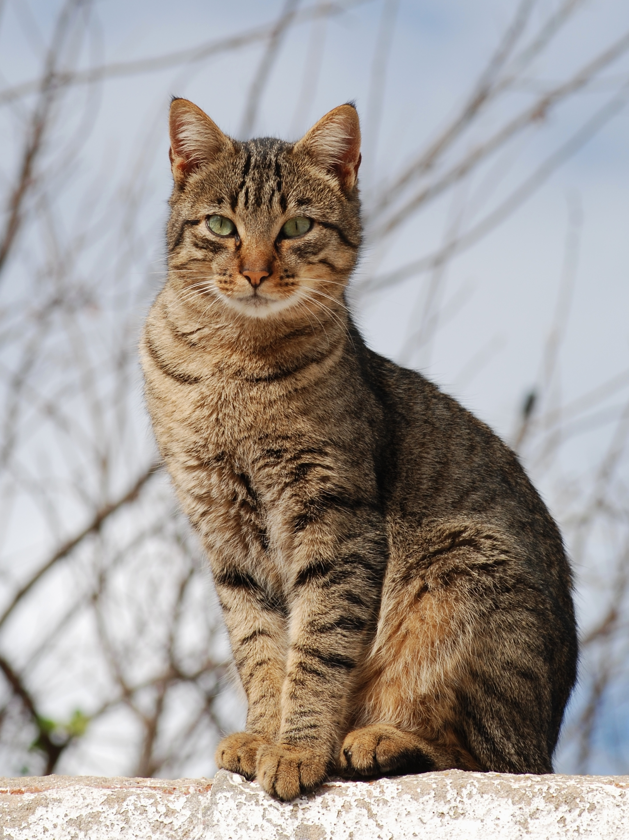
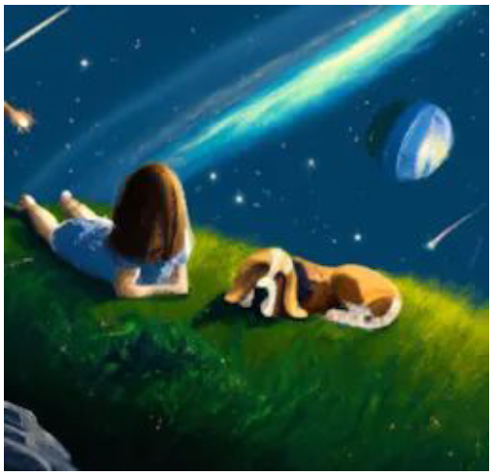
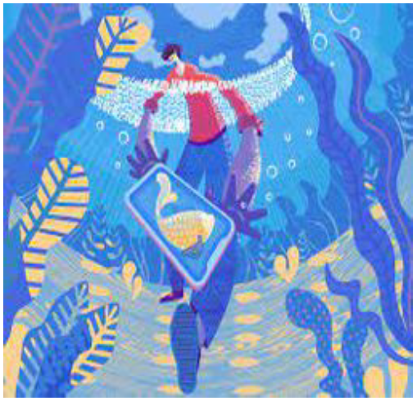
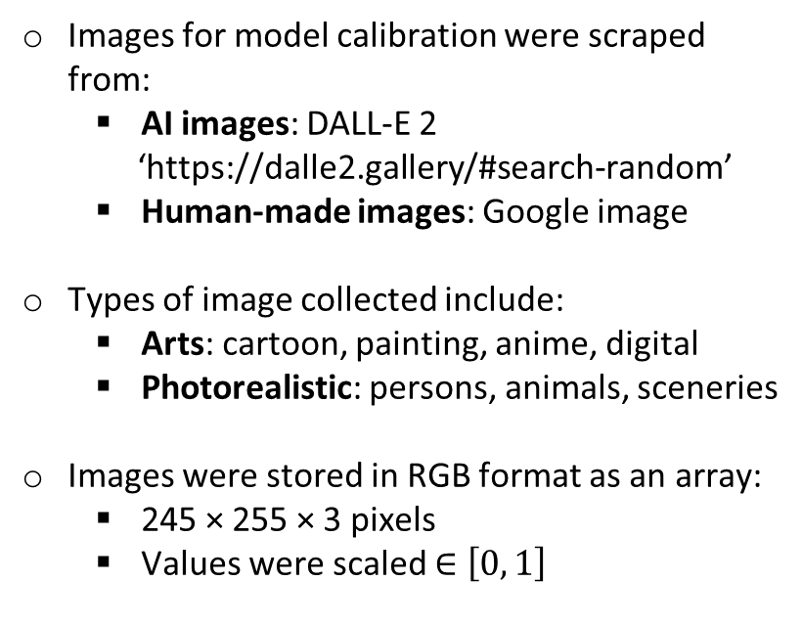
Data Collection
AI
Human
Images for model calibration were scraped from:
AI images: DALL-E 2
‘https://dalle2.gallery/#search-random’
Human-made images: Google image
Types of image collected include:
Arts: cartoon, painting, anime, digital
Photorealistic: persons, animals, sceneries
Images were stored in RGB format as an array:
245 × 255 × 3 pixels
Values were scaled $∈\left[0, 1\right]$
Cat
Painting

Slide 13
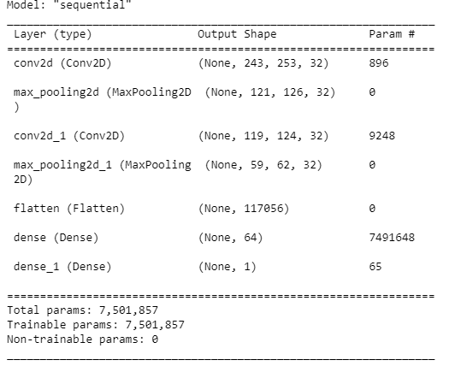
Model Architecture
Model has 7.5 million trainable parameters
Input layer is an array of size (245, 255, 3)
245 × 255 RGB pixels
Model is trained with binary cross entropy to output either:
1: For Dalle-E generated images
0: for Human made images

Slide 14
Training & Testing
Training is performed the 9000 images over 10 times. The 9000 images are split into batches of 1800 images (5 batches) and the model is trained iteratively on these batches
Testing performed on a batch of 930 DALL-E 2 and 650 human generated images
“Adam” optimizer is used with a learning rate of 0.00005
Notes:
Model was trained for 10 epochs on 5 batches of 1800 images. So a total of 9000 images were used to train the model split equally between DALL-E generated and Human made images:
Sub-sentence
Test batch was 1580 images 930 of which were dall-e generated and 650 human made:
Sub-sentence

Slide 15
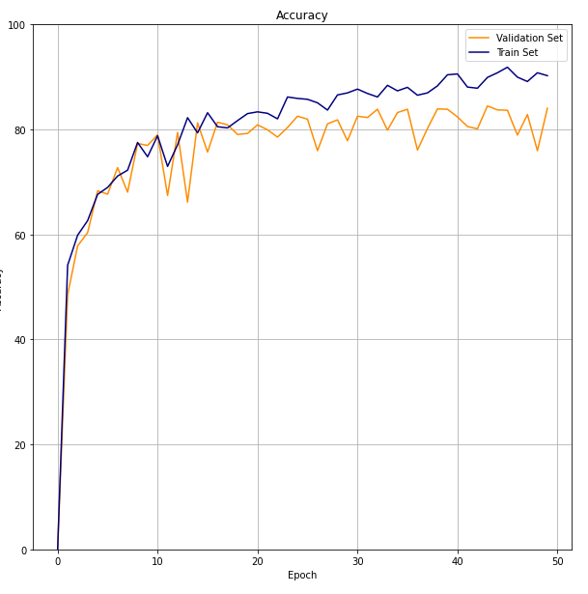
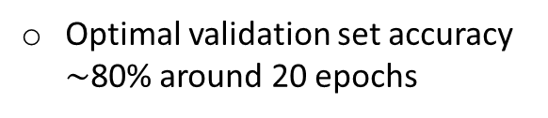
Results: Accuracy
Optimal validation set accuracy $\sim$80% around 20 epochs
Notes:
The 50 epochs on the graph for accuracy are because of the 10 epochs for 5 batches (10x5 = 50):
I’ve made graphs of accuracy, confusion matrix (for fp tp fn and tn rates), and the ROC and AUC curve
Sub-sentence

Slide 16
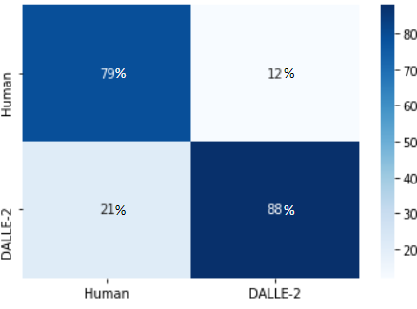
Results: Confusion Matrix
Confusion Matrix
88% correctly labeled DALL-E 2 images
79% correctly labeled human-made images
Predicted
Actual
Notes:
The 50 epochs on the graph for accuracy are because of the 10 epochs for 5 batches (10x5 = 50):
I’ve made graphs of accuracy, confusion matrix (for fp tp fn and tn rates), and the ROC and AUC curve
Sub-sentence

Slide 17
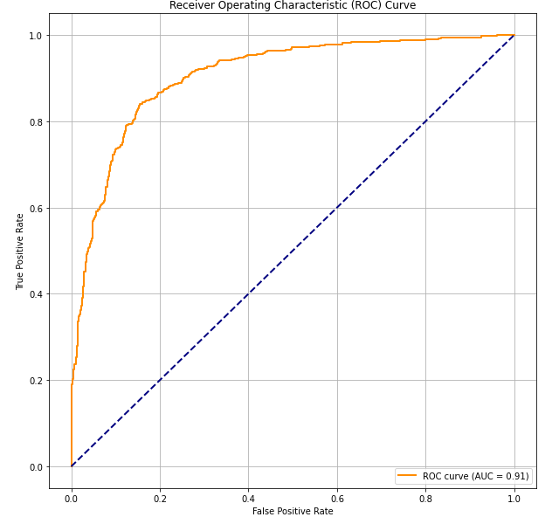
Results: ROC Curve
Area under curve: 0.91
High performing sensitivity and specificity trade-off
Relatively high true positive and low false positive rate
Notes:
The 50 epochs on the graph for accuracy are because of the 10 epochs for 5 batches (10x5 = 50):
I’ve made graphs of accuracy, confusion matrix (for fp tp fn and tn rates), and the ROC and AUC curve
Sub-sentence

Slide 18
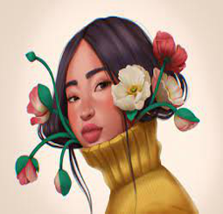
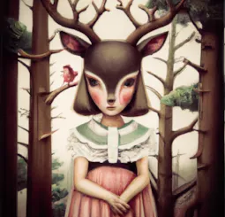
Results: Examples
(A)
(B)

Slide 19
Results: Examples
(A) DALL-E 2
Model output: 0.99
(B) HUMAN
Model output: 0.048

Slide 20
Discussion
Limitations:
Small image selection, lots of styles of images the model has not seen before
Future work:
Incorporate more AI image generators (Mid-journey / Stable diffusion etc.)
Importance of work and usage:
To explore weaknesses in image generators and detect fake or harmful content

Slide 21
Summary
Convolutional Neural Networks (CNN) to detect images generated by DALL-E 2
Trained on 9000 image examples split equally between human generated and DALL-E 2 generated images of various styles (art-photorealistic)
Overall 84 percent accuracy on a validation set of 1530 images
Model generalizes well and does not fit to one class more strongly (equal false positive and negative rates)
Future work to expand the model to detect images generated by different AI generators as well

Slide 22

Thank You

